Slide 1

DriverPass System Analysis
Joshua Donnelly
Notes:
[No speaker notes required for this slide.]

Slide 2

System Requirements
Functional Requirements:
The system shall Validate user credentials when logging in. This should meet the customers request for security tracking and ensuring different rights and roles are enforced
The system shall Enable students to schedule on-the-road training sessions with instructors and cars. This should meet the main focus of the system to allow Driver Pass to fill the market void for training driving students
Non-Functional Requirements:
The system online platform should be accessible on major web browsers and mobile devices. This will allow the system to connect with customers and also allow the employees to access data from anywhere.
The system should utilize cloud hosting to handle backup, security, and technical aspects. This will ensure the security requirements to protect, store and access user information without the additional cost of new hardware.
Notes:
[In your speaker notes, include an explanation of the different requirements you determined for DriverPass’s system. What are the functional requirements you selected to describe? What are the nonfunctional requirements you selected to describe? Be sure to explain how these requirements meet DriverPass’s needs.]

Slide 3
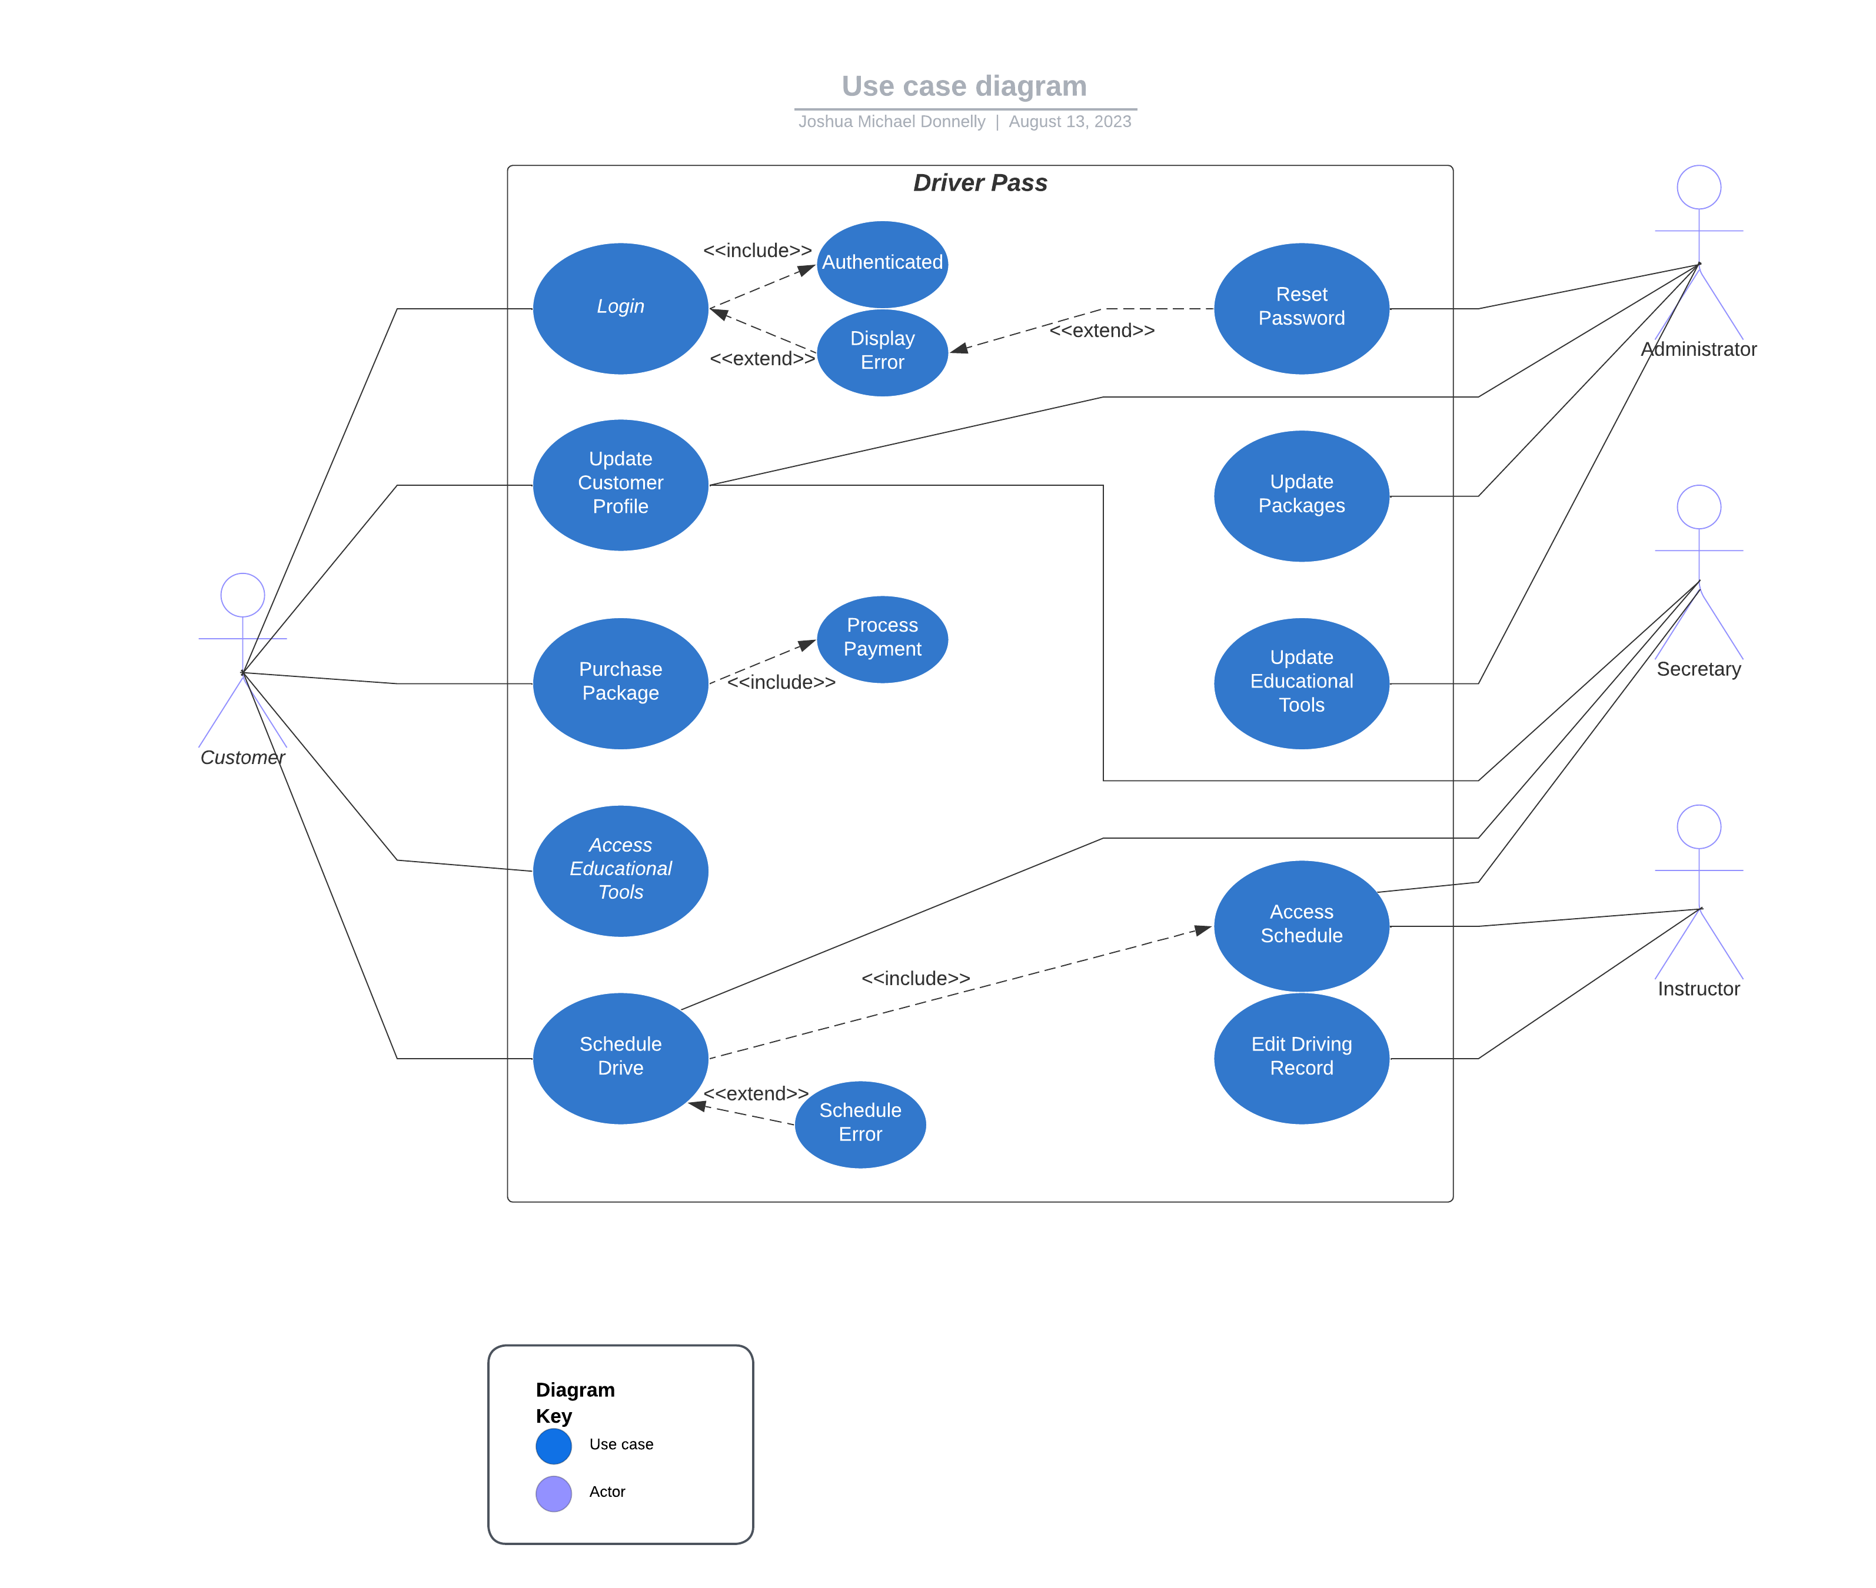
Use Case Diagram
These are the different methods in place to perform the functions of your system, the different relationships between them, and the people who will perform them
Notes:
[Explain your diagram. Who are the different actors in the system? What are the different use cases? How did you account for DriverPass’s needs in your design? In your explanation, keep your audience in mind. Avoid the use of terms like “actors” and “use cases” in your explanation.]

Slide 4
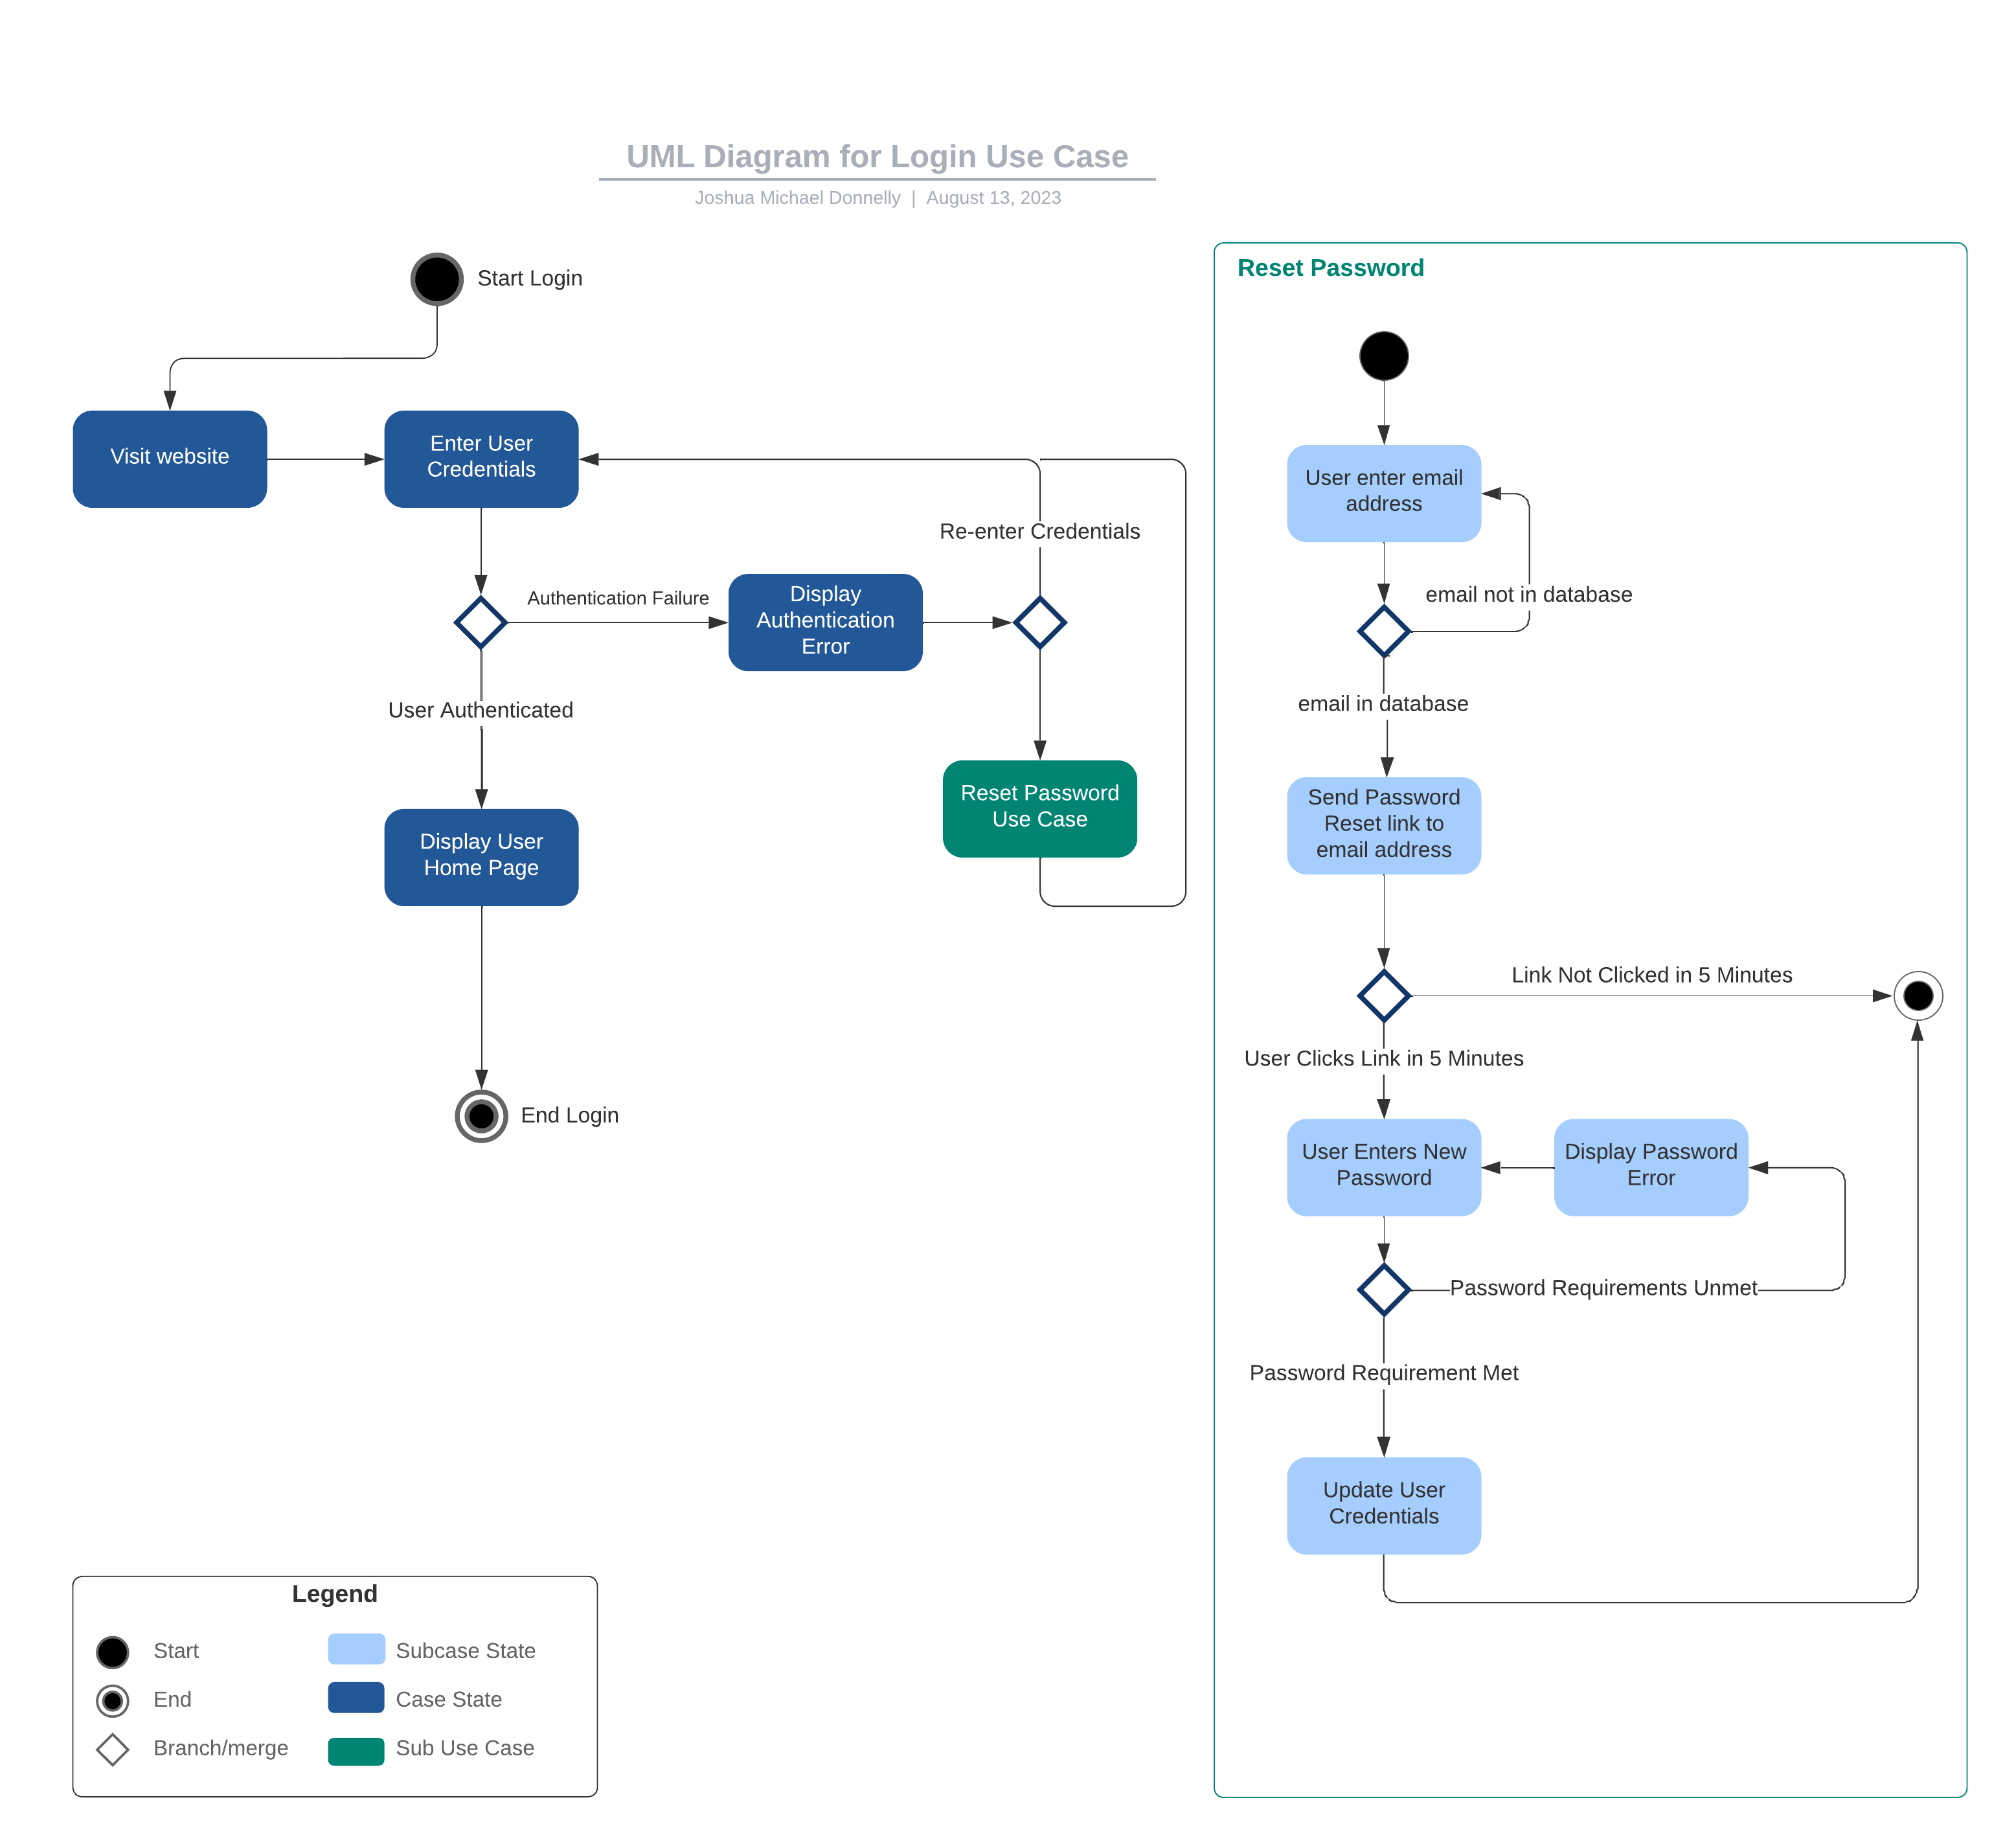
Activity Diagram
This is a system diagram explaining the login process into the system along with a sub process involving resetting the password if forgotten
Notes:
[Explain your diagram. Which use case are you breaking down? What are the steps for this use case? How did you account for DriverPass’s needs in your design? In your explanation, keep your audience in mind. Avoid the use of technical terms such as “nodes,” “control flows,” and so on.]

Slide 5
Security
Using Cloud hosting helps ensure backups and security measures are in place to make sure data is secure and never lost in emergency situations
Keeping information from each user private unless necessary and ensuring data that is accessed is by employees with the correct role if it is necessary
Creating different types of employee roles to reduce the likelihood of access from a source not intended
Requiring authentication when logging in and using a secure method to recover a forgotten password
Notes:
[How did you consider security in your design? In your explanation, keep your audience in mind by avoiding the use of technical terms.]

Slide 6
System Limitations
The limitations of the system include:
Customer satisfaction is limited to the provided library of tools and the expertise of the instructors
No system is 100% secure the system will follow the best practices of the industry to ensure the privacy and security of the system data
There is no guarantee if the system is used in a way that is not aforementioned
This system cannot make any future guarantees against security flaws that may appear in the future
There are no guarantees against the security provided by the cloud hosting platform
There may be additional resources required if the scale of customers or employees is increased substantially
Any outside systems or connections cannot be guaranteed
Notes:
[What are the limitations of your design? In your explanation, keep your audience in mind by avoiding the use of technical terms.]

